Slide 1
Hacking Humans
Real-Life Methods, Models, and Theories
© 2013 Hunter Storm. All rights reserved.

Slide 2
Social Engineering
Building a More Secure World Thru Innovative Use of the Truth

Slide 3
Overview
What is Social Engineering?
Hacking humans
Sanitized stories
How to guard against it
Questions

Slide 4
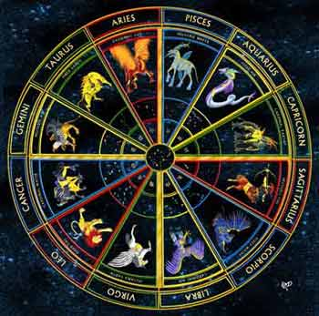
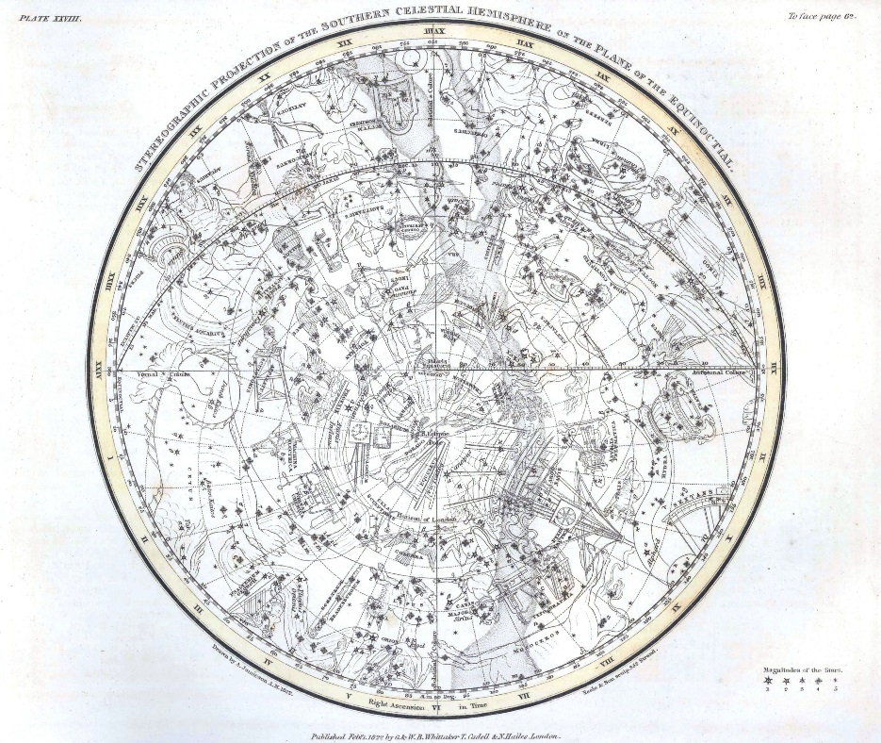
Social Engineering:
Fact or Fiction?
ASTROLOGY
ASTRONOMY

Slide 5
What is Social Engineering?
Wikipedia: 1) the practice of obtaining confidential information by manipulating users. 2) the practice of using psychological manipulation tactics to help or harm others
Both easiest and most difficult hack
Why use it:
  Criminals—no l33+ $k1lz required
  Formal penetration testing teams
  Getting things done at work (privilege escalation)
  Improving interpersonal relations

Slide 6
Hacking Humans
Goal(s)—what do you want?

Slide 7
Why Do People Fall for It?
Stupid?
Gullible?
Lazy?
Exploitable!

Slide 8
How to Hack Humans
/** Pwn$ {u}
Penetration Testing
Control resources
Leave backdoor
Cover tracks

Slide 9
Services & Ports
Human and machine networks are same (just quirkier)
  Humans
    Self-esteem
    Apathy
    Sadness
    Happiness
    Gregariousness
    Ego / self-interest
    Benefit to self
    Commonalities
    Helpfulness
    Belonging
  Ex.: Bar pickup vs. wives (Bastion host in DMZ vs. standalone PKI root CA)
Hosts
  telnet
  ftp
  sftp
  IpSec
  Pop

Slide 10
HumInt
The Hidden Element
KNOW YOURSELF!!!
IPX/SPX vs. TCP/IP

Slide 11
HDLP
Human Data Leak Protection

Slide 12
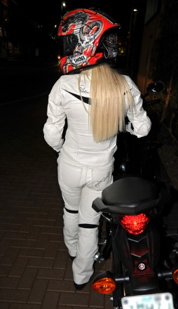
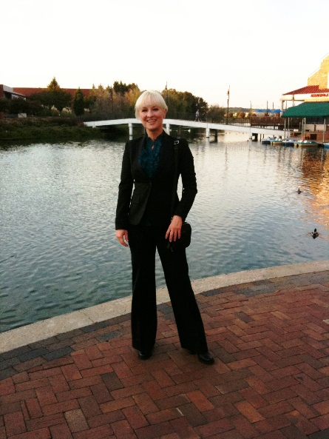
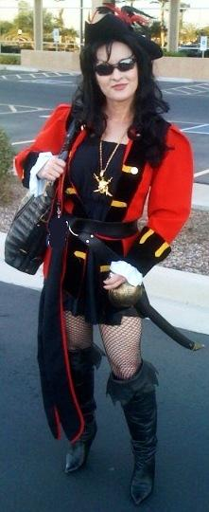
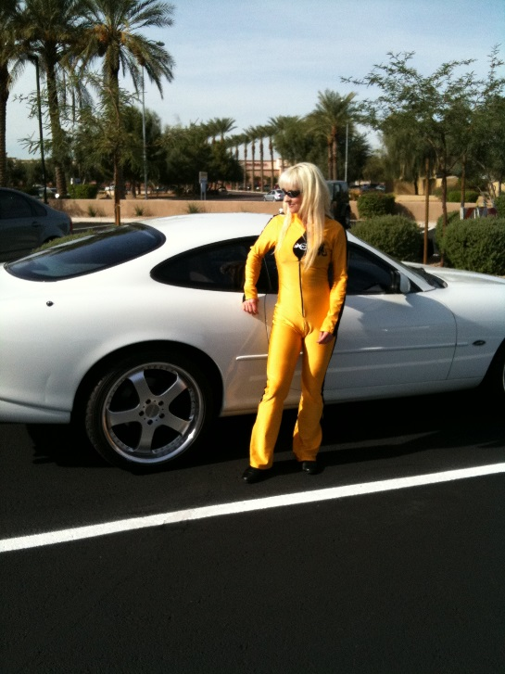
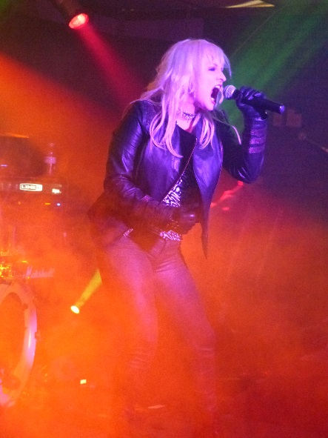
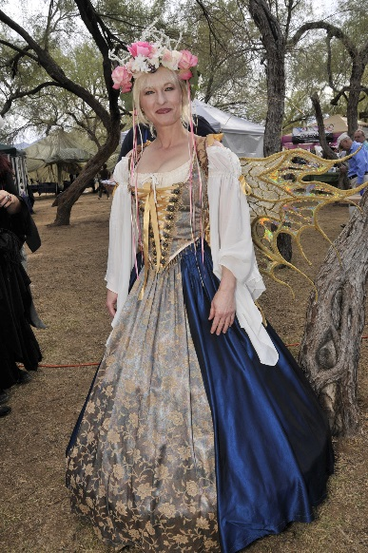
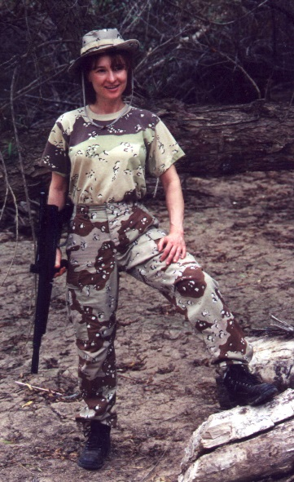

DRESS the PART!

Slide 13
Exploit Vulnerabilities
Brain firewalls & content filters
Finesse / Elicitation
PKI model

Slide 14
HumInt
DON’T
  Run an MS Office exploit against a BSD OS
  Keep hammering a port you can tell is closed (SSH ain’t running on :8080 . . .)
    will get you blacklisted
    script kiddy vs. l33+ h@x04 (your neighbor’s kid vs. Kevin Mitnik)
DO!
  Know your target!
    Background
    Motivators
    Likes/dislikes
  Proceed with caution
  Finesse vs. not brute force (Hacker Ethic, don’t leave it worse than you found it) ;)
  Ex: Hammurabi village & corn

Slide 15
Sanitized Stories – irl ’spl01+$
USB drives
South American NOC service technicians
Root-level CA and registrar server co-opt
Fortune 100 datacenter badging / geometry
Fortune 100 server heist w/ guards

Slide 16
How to Guard Against It
Self-Knowledge
Education
Remain vigilant
Trust but verify
ALWAYS follow policies, baselines, and guidelines to the letter!

Slide 17
Questions?

Slide 18
Legal Notices
Hacking Humans™ (copyright 2005), The Storm Model of Social Engineering™ (copyright 2002), Security by Storm™, Motorcycling by Storm™, Body by Storm™, by Storm™, and the by Storm™ logo are registered trademarks of Hunter Storm™. The name Hunter Storm™ and the Hunter Storm™ logo are registered trademarks of Hunter Storm™. Trademark, copyright, and other intellectual property laws protect all names, characters, images, and logos. All rights in the products and creations identified below are owned by and property of by Storm, LLC. All logos and symbols used in this book are registered trademarks and copyrights of Hunter Storm™. Hunter Storm™ owns the copyrights in all of the writings, including all visuals, characters, and other elements of the book, website, and videos. Any similarities to persons living or dead are purely coincidental. Of course, my similarity to myself is intentional.
All rights reserved. With the exception of artwork used for review purposes, none of the contents of this presentation, books, videos, website, or other intellectual property may be reproduced or transmitted in any form or by any means whatsoever, including copying, recording or by any information storage and retrieval system, without the written permission of Hunter Storm™.

